Slide 2
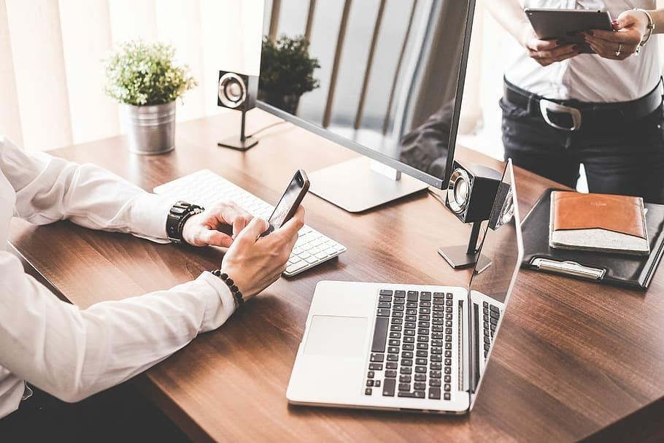
CONTENTS
01.
ABOUT US
GMC and Blockchain
02.
Roadmap
What,When and How
03.
Investments Opportunity
Private & Pre sale offers
04.
Integration
How to buy using different wallets
GM INFORMATICS JOINT STOCK COMPANY | 2021

Slide 3
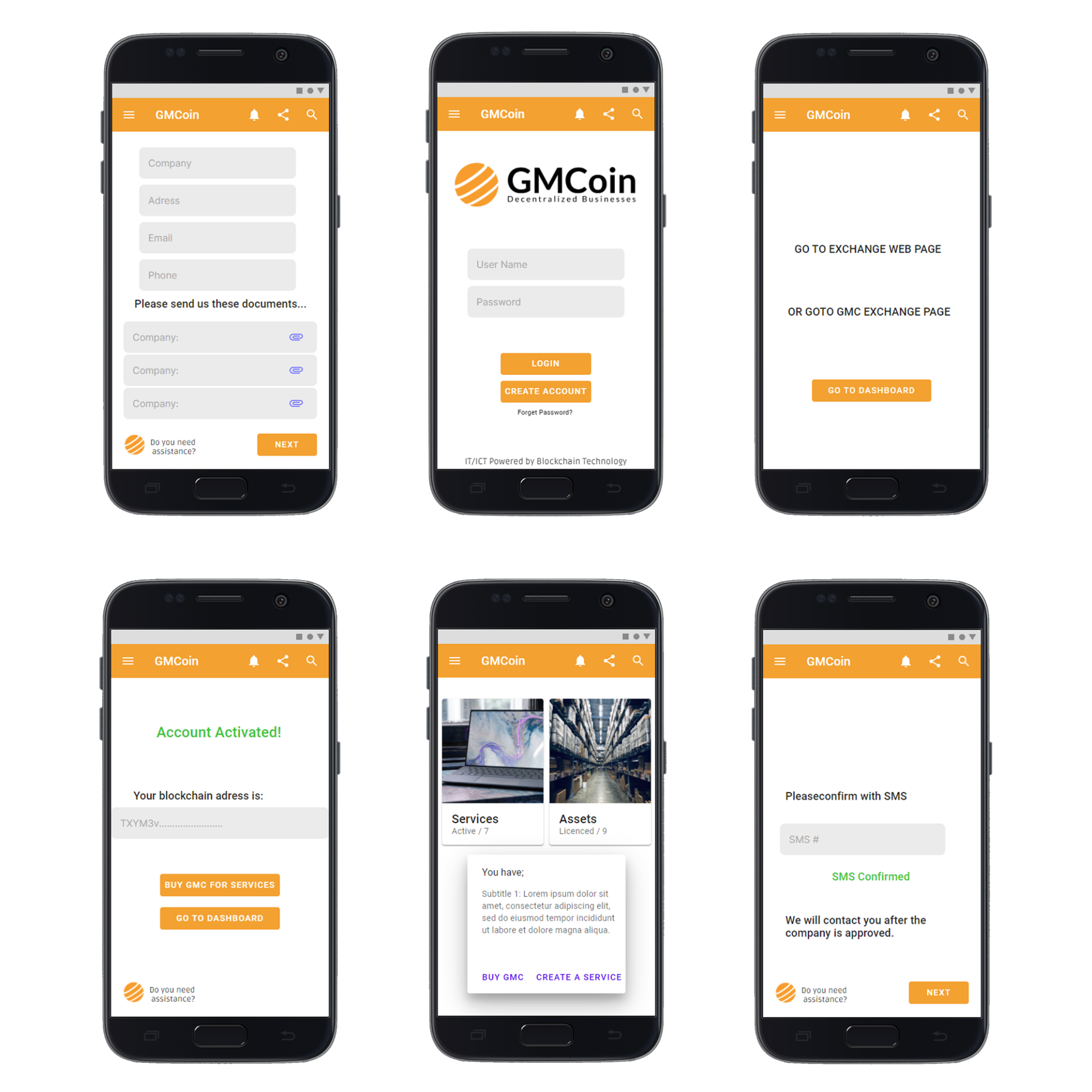
ABOUT US
GM Informatics JSC is a Highest Grade Joint Stock Company registered and trademarked in Turkey since 2009. GM Informatics JSC is ISO/IEC 27001 Accredited company maintaining 2500+ IT Assets. GM Informatics will be the First Tokenized Company in the World with its Tron Blockchain based $GMCoin ecosystem.
$GMCoin based IT/ICT Management Systems backed by ITIL and COBIT ITSM principles has already designed and ready for its alpha stage customer launch!
01.
02.
Team Members with experience over 20+ years, maintaining 2500+ IT assets
First Tokenized Company in the World to enable corporates tokenization

Slide 4
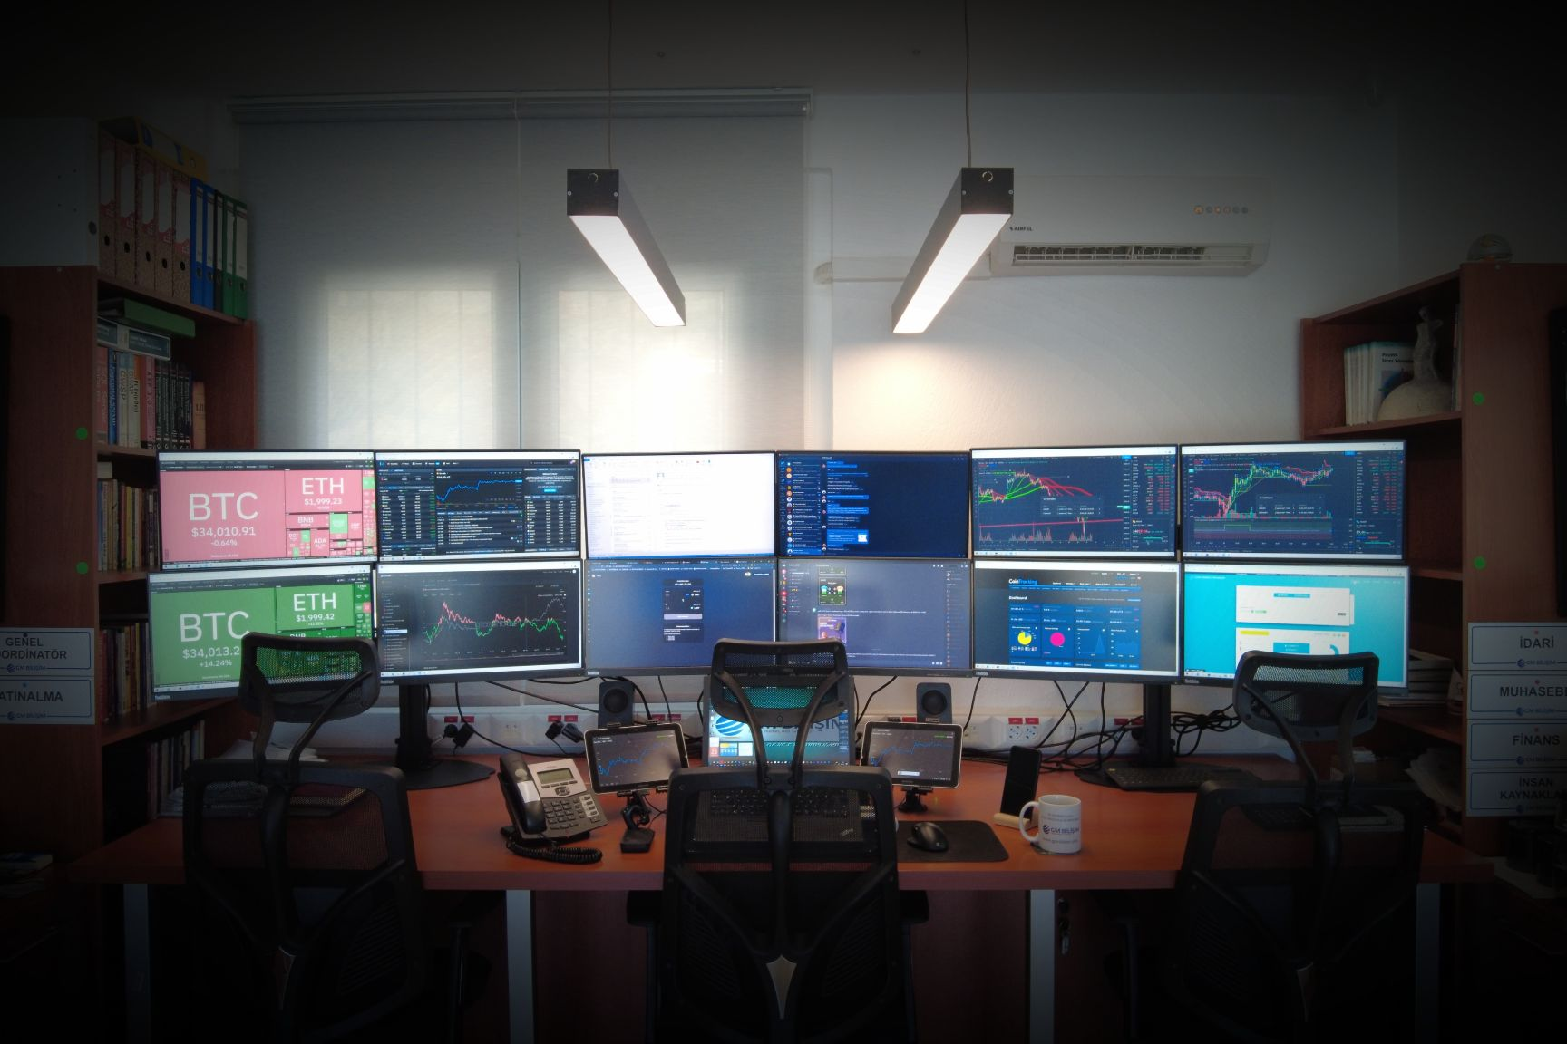
$GMCoin, Decentralizing Businesses
GMCoin tries to promote the use of the blockchain within any environment and commercial sector, developing a token called GMCoin accompanied by business strategies and innovative projects that allow access for all (Small and Large Merchants, buyers, users and general public) to a transparent and decentralized economy to be able to interact effectively and quickly with technology.
Powered by TRON Network
TRC-10 Based
Interchangeable
Low cost of ownership
Maximum supply of 80m
Real Company
Dapps Ready
Decentralized
Transparent
Multi-Wallet Ready
Supported by «GM Informatics» ecosystem and trade system

Slide 5
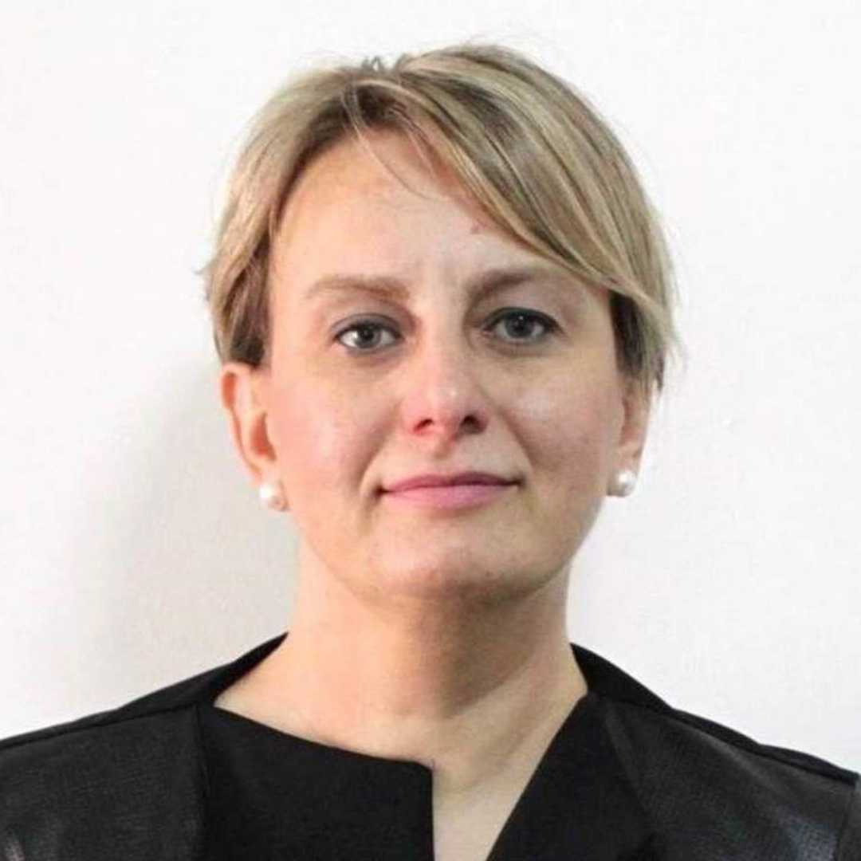
HEAD TEAM
Mehmet Ali DEMİRCİ
Founder / CEO
Ömer Reşad Kayran
Bedriye Koç
Mustafa Toker
Lawyer / Advisor
CPA / Advisor
Lawyer / Advisor
The company also working with many partners and outsourced companies from different countries like; Estonia, India, Pakistan, Hong Kong, China, Portugal and Brazil

Slide 6
TOKEN OVERVIEW
Starting from the previous premise, where the value of the currency is based on quality stimulates the increases its value, Informatics; we have trust the use and as GM initiated a complete ecosystem where the use of our currency is necessary; and we rely on the transparency of the blockchain to build trust.
48M
10M
14M
8M
Fair Public Sale
Customer Private Sale & Token Distribution
Team & Marketing
Retained by GM
From Pre-ICO Portal, LaunchPad, Bridge, Swap and Teleportation Platforms
Allocation for loyal customer base
Reserved
Reserved

Slide 7
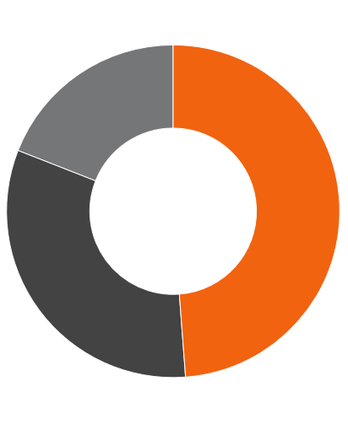
TARGET MARKET
As the whole idea is about decentralization of businesses through unbeatable Blockchain technology, the borders aren’t the limitations any more.
By Sector
IT, Creative, Consulting, Real estate, etc
By Location
Initially Targeting European and Asian Markets
By Size
From Small to Mid-sized enterprises are the primary targets

Slide 8
Opportunities for Retail Investors
Crackers Round (Limited Sale)**
$0.06/GMC
~50% Discount
Fixed: $60
Accepted Currencies: USDT (TRC20) ( Crypto - walletconnect )
Round I**
Round II**
Round III**
$0.07/GMC
$0.08/GMC
$0.09/GMC
~40% Discount
~30% Discount
~20% Discount
Details:
Details:
Details:
Min/Max: $70/$2,100
Accepted Currencies: USDT (TRC20), TRX
( Crypto - walletconnect )
Min/Max: $60/$2,000
Accepted Currencies: USDT (TRC20), TRX
( Crypto - walletconnect )
Min/Max: $45/$1,800
Accepted Currencies: USDT (TRC20), TRX
( Crypto - walletconnect )

Slide 9
Opportunities for Private Investors
Round I**
Round II**
Round III**
$0.07/GMC
$0.08/GMC
$0.09/GMC
~40% Discount
~30% Discount
~20% Discount
Details:
Details:
Details:
Min/Max: $175/$35,000
Accepted Currencies: TRY (Fiat), BTC,BCH,LTC,ETH,BNB,USDC
Min/Max: $160/$32,000
Accepted Currencies: TRY (Fiat), BTC,BCH,LTC,ETH,BNB,USDC
Min/Max: $135/$27,000
Accepted Currencies: TRY (Fiat), BTC,BCH,LTC,ETH,BNB,USDC

Slide 10
Final Round & Listing
Last Catch**
Listing
Listing
$0.10/GMC
PROBIT
LBANK
10% Discount
Details:
Details:
Details:
Min/Max: $10/$1,000
Accepted Currencies: USDT (TRC20), TRX
( Crypto - walletconnect )
All Deposits and Trades
will be open
All Deposits and Trades
will be open

Slide 11
MARKETING STRATEGY
With a strong community support over Telegram & Twitter, we are already in a process of collaborations and partnerships with various Exchanges, Social Influencers, Capitalist, Investors, Business owners and Entrepreneurs.
01.
02.
Online/Offline Sponsorships
AMA’s, Podcasts, Interviews over Tier I outlets
03.
04.
Social and Search Engine Ads
Collaborations with Top 20 Crypto Exchanges

Slide 12
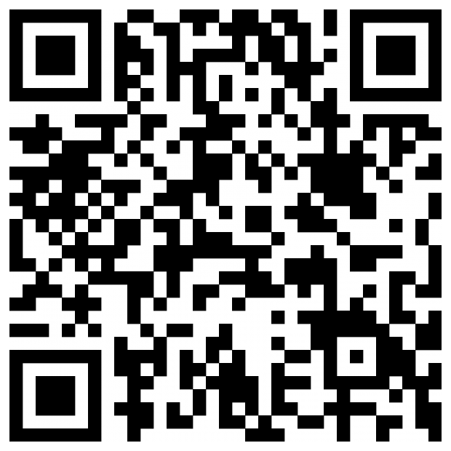
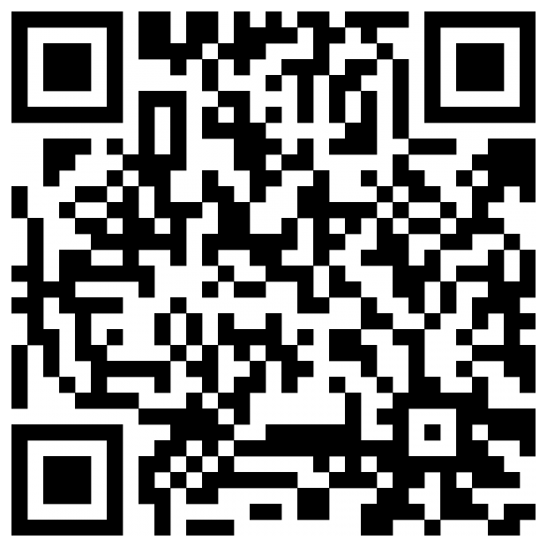
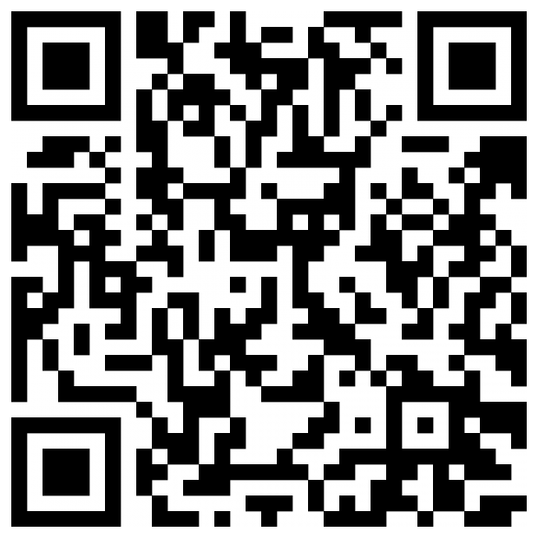
Wallets’ Supports GMC
Klever Wallet
Math Wallet
Huobi Wallet

Slide 13
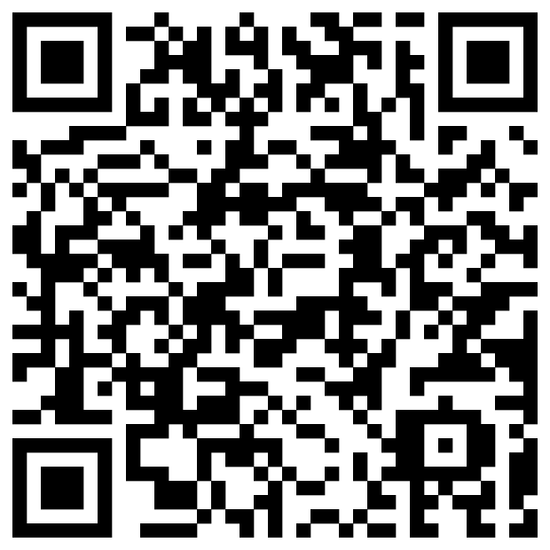
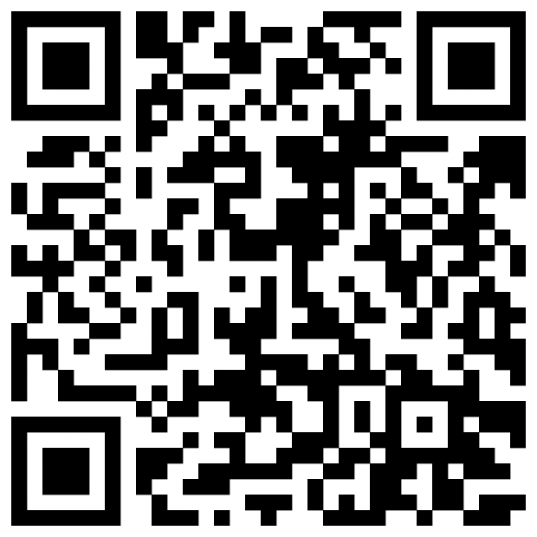
Wallets’ Supports GMC
Tronlink Wallet
Trust Wallet

Slide 14
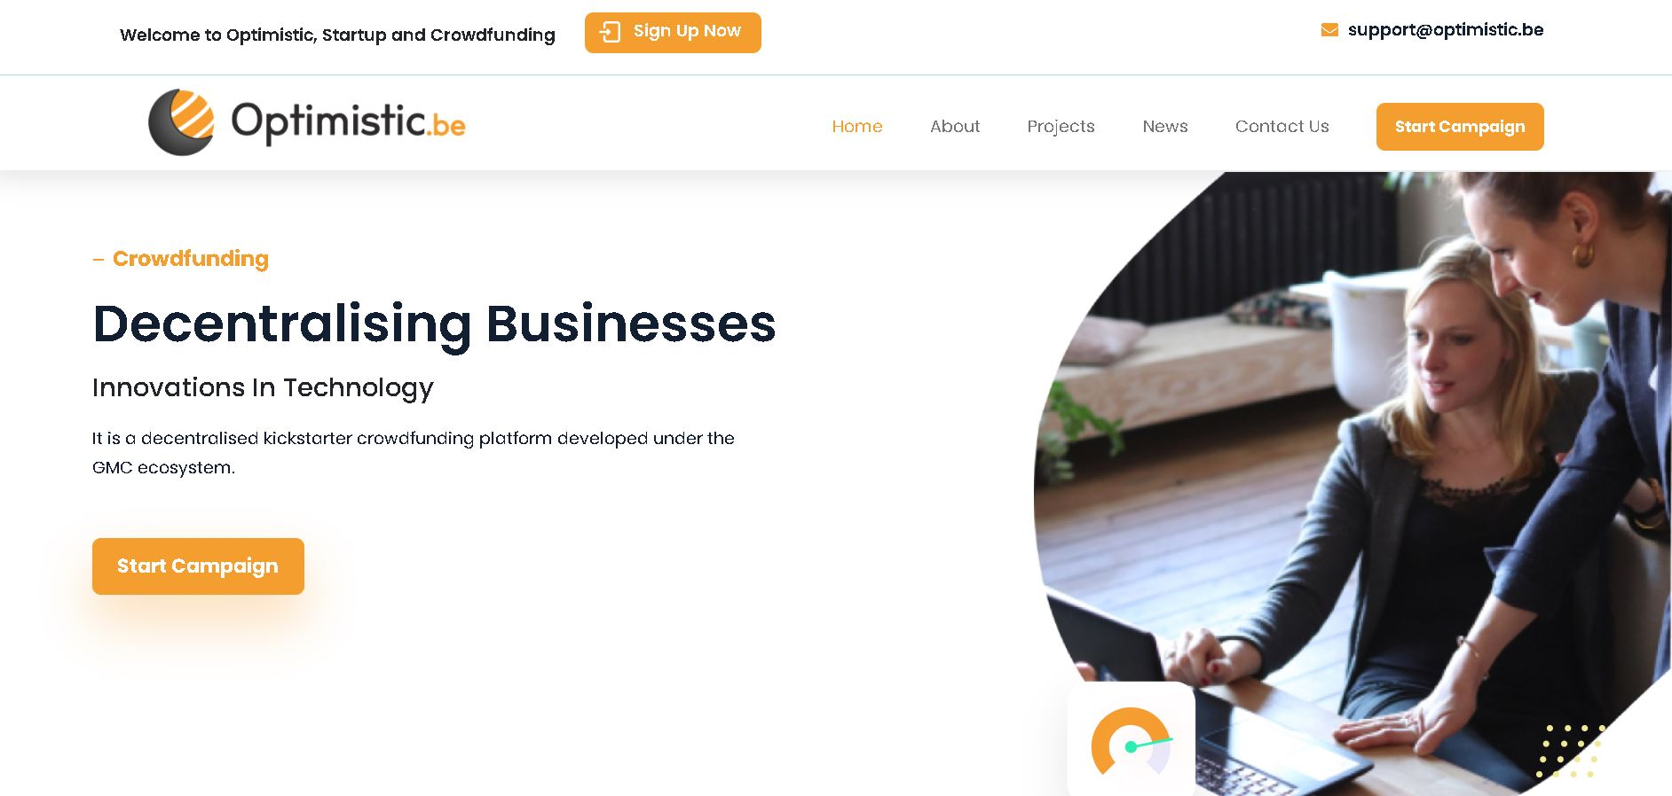
Optimistic.be (MVP by $GMCoin)
Optimistic.be is designed to be an all-in-one platform-marketplace-exchange for holders of GMCoin, decentralised kickstarter crowdfunding, tokenized assets, commodities and real estate tokenization platform is being developed under the GMC ecosystem.
Kickstarter projects, Startups can be easily funded via GMCoin, powered by decentralization concepts and security mechanism to protect investors,
Real world stocks, assets, commodities can easily accessible with GMCoin,
By the help of global real estate agents, investors will be able to invest in tokenized real estates, can get benefit from rentals and the sale of the real-estate on long-term basis.

Slide 15
CONTACT US
DISCLAIMER
HIGH RISK INVESTMENT
Trading cryptocurrencies carries a high level of risk, and may not be suitable for all investors. Before deciding to trade cryptocurrency you should carefully consider your investment objectives, level of experience, and risk appetite. The possibility exists that you could sustain a loss of some or all of your initial investment and therefore you should not invest money that you cannot afford to lose. You should be aware of all the risks associated with cryptocurrency trading, and seek advice from an independent financial advisor. ICO’s, IEO’s, STO’s and any other form of offering will not guarantee a return on your investment.
Since, Any opinions, news, research, analyses, prices, or other information contained on this website is provided as general market commentary, and does not constitute investment advice. GMCoin will not accept liability for any loss or damage, including without limitation to, any loss of profit, which may arise directly or indirectly from use of or reliance on such information. All opinions expressed on this site are owned by the respective writer and should never be considered as advice in any form.
GMCoin makes no representation or warranties as to the accuracy and or timelines of the information contained herein. A qualified professional should be consulted before making any financial decisions.
ADDRESS
Bitez Mah. – Saldır Şeyh Cad. – No:2/B – Bodrum / Turkey
Telegram
https://t.me/gmcoin
WEBSITE
https://gmc.gm-informatics.com/

